Slide 1
MARKOV CHAIN
Unit 4

Slide 2
Outline
Features,
Process Examples,
Applications

Slide 3
MARKOV CHAIN
A Markov chain or Markov process is a stochastic model describing a sequence of possible events in which the probability of each event depends only on the current state attained in the previous event.
A Markov chain is a mathematical system that moves from one state to another according to certain probabilistic rules.
A Markov chain is a discrete-time process for which the future behavior, given the past and the present, only depends on the present and not on the past.
It's like a game where you're in a specific situation, and what happens next only depends on your current situation, not on how you got there.
Notes:
Markov analysis is a method used to forecast the value of a variable whose predicted value is influenced only by its current state

Slide 4
MARKOV CHAIN
In simpler terms, it is a process for which predictions can be made regarding future outcomes based solely on its present state and—most importantly—such predictions are just as good as the ones that could be made knowing the process's full history.
Markov analysis is a method used to forecast the value of a variable whose predicted value is influenced only by its current state, and not by any prior activity.
Markov chains are a fairly common, and relatively simple, way to statistically model random processes.
The primary advantages of Markov analysis are simplicity and out-of-sample forecasting accuracy.
A game of snakes and ladders or any other game whose moves are determined entirely by dice is a Markov chain.

Slide 5
MARKOV CHAIN
A Markov chain is a mathematical system that undergoes transitions from one state to another according to certain probabilistic rules. The defining characteristic of a Markov chain is that no matter how the system arrived at its current state, the possible future states are fixed. In other words, the probability of transitioning to any particular state is dependent solely on the current state and time elapsed.
Markov chains have many applications in various fields, including economics, biology, computer science, and more. They are often used to model and predict the behavior of complex systems that can be in multiple states.
For example, a Markov chain could be used to model the behavior of a person moving between different cities, where the probability of moving from one city to another depends on the current city and the time of year. The states in this case could represent different cities, and the transitions between states could represent the person moving from one city to another.

Slide 6
MARKOV CHAIN
A state is any particular situation that is possible in the system. For example, if we are studying rainy days, then there are two states:
It's raining today.
It's not raining today.
The changes of state of the system are called transitions.
If a Markov chain consists of k states, the transition matrix is the k by k matrix whose entries record the probability of moving from each state to another state.

Slide 7
MARKOV CHAIN
A Markov chain is a process that consists of a finite number of states with the Markovian property and some transition probabilities p_{ij}, where p_{ij} is the probability of the process moving from state i to state j.
A Markov chain consists of state and transition probabilities.
Each transition probabilities is the probability of moving from one state to another in one step.
The transition probabilities are independent of the past and depend only on the current states involved.
The matrix of transition probabilities are called transition matrix.

Slide 8
Features
A Markov chain is a random process with the property that the next state depends only on the current state.
A sequence of trail of an experiment is a Markov chain if:
The outcome of each experiment is one of a set of discrete state. (countable number of states)
The outcome of the experiment depends only on the present state and not on the past state.
The transition probability remains constant from one to the next.

Slide 9
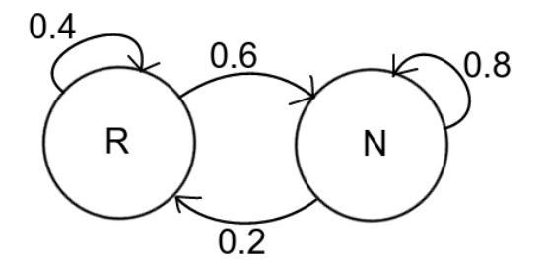
Markov chain diagram:
Let's illustrate using rainy days example. The probabilities for the system might be:
If it rains today (R), then there is a 40% chance it will rain tomorrow and 60% chance of no rain.
If it doesn't rain today (N), then there is a 20% chance it will rain tomorrow and 80% chance of no rain.
It may help to organize this data in what we call a state diagram. In this diagram appearing here, the left circle represents rain (R), and the right represents no rain (N). The arrows indicate the probability to change state. For example, the arrow from R to N is labeled 0.6 because there is a 60% chance that if it rains today, then it won't rain tomorrow.

Slide 10


Markov chain diagram:
A simple weather model
The probabilities of weather can be represented by a transition matrix:
The matrix P represents the weather model in which a sunny day is 90%, likely to be followed by rainy day, and a rainy day is 50% likely to be followed by sunny day. The state can be labelled "sunny" and "rainy",.

Slide 11
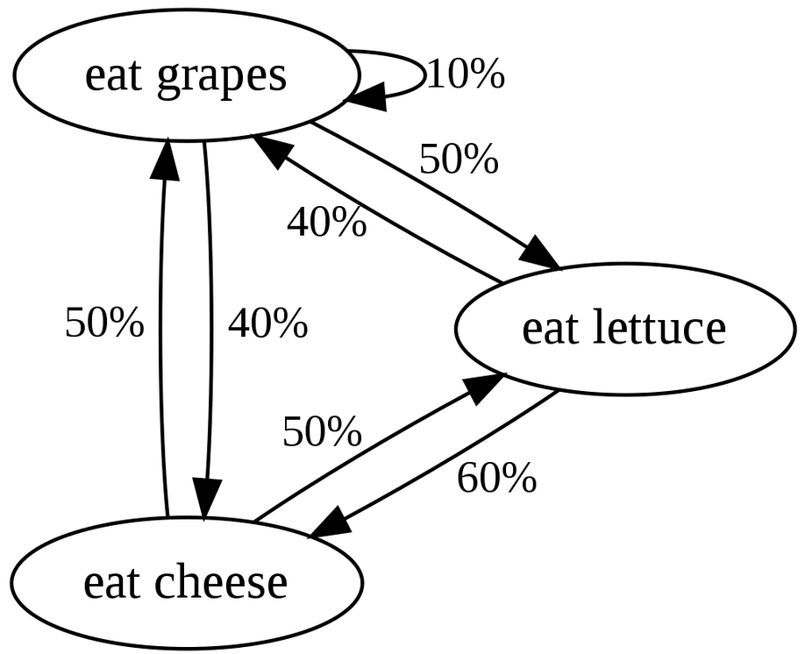
Markov chain diagram:
Another example is the dietary habits of a creature that eats only grapes, cheese, or lettuce, and whose dietary habits conform to the following rules:
It eats exactly once a day.
If it ate cheese today, tomorrow it will eat lettuce or grapes with equal probability.
If it ate grapes today, tomorrow it will eat grapes with probability 1/10, cheese with probability 4/10, and lettuce with probability 5/10.
If it ate lettuce today, tomorrow it will eat grapes with probability 4/10 or cheese with probability 6/10. It will not eat lettuce again tomorrow.

Slide 12
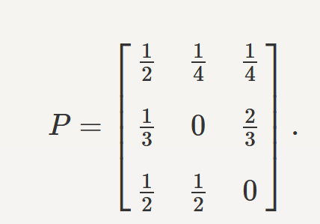
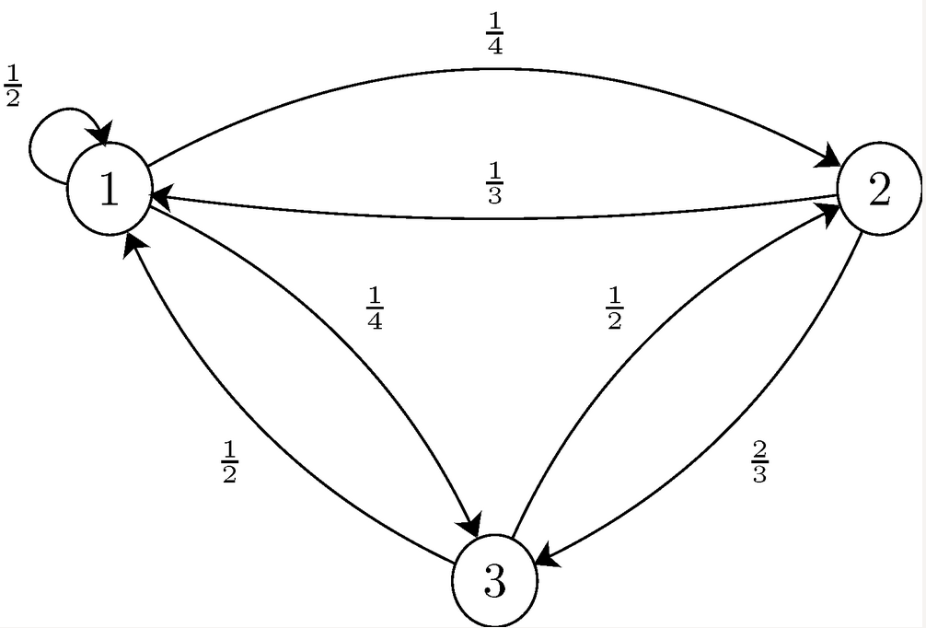
Markov chain diagram:
Consider the Markov chain with three states, S={1,2,3}, that has the following transition matrix
Draw the state transition diagram for this chain.

Slide 13
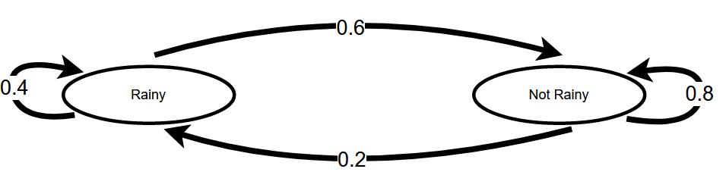
Markov chain diagram:
Rainy today
40% Rainy tomorrow
60% not Rainy tomorrow
Not rainy today
20% Rainy tomorrow
80% not Rainy tomorrow
Create transition matrix and draw chain diagram

Slide 14
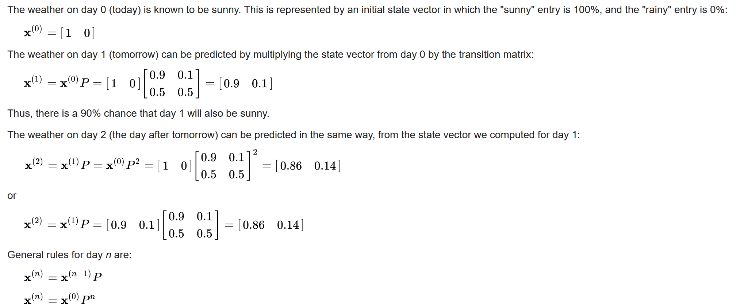
Process Example
Predicting the weather
Notes:
Slide 10 solved

Slide 15
Examples 1
Not Rainy today
40% Rainy tomorrow
60% not Rainy tomorrow
rainy today
20% Rainy tomorrow
80% not Rainy tomorrow
Create transition matrix and draw chain diagram
2. What will be probability if todays is not raining then rain day after tomorrow?
X_{o} = [1 0] or [0 1] ???? (today)
X1 = X_{o} * (P)¹ (tomorrow)

Slide 16
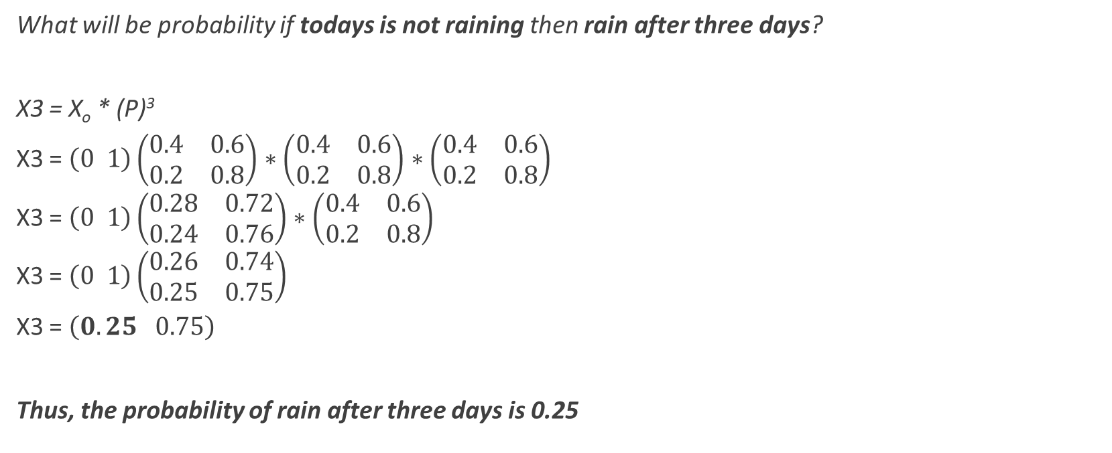
Examples 1
What will be probability if todays is not raining then rain after three days?
X3 = X_{o} * (P)³
X3 = $\left(0 1\right)\left(\begin{matrix}0.4 & 0.6 \\ 0.2 & 0.8\end{matrix}\right)∗\left(\begin{matrix}0.4 & 0.6 \\ 0.2 & 0.8\end{matrix}\right)∗\left(\begin{matrix}0.4 & 0.6 \\ 0.2 & 0.8\end{matrix}\right)$
X3 = $\left(0 1\right)\left(\begin{matrix}0.28 & 0.72 \\ 0.24 & 0.76\end{matrix}\right)∗\left(\begin{matrix}0.4 & 0.6 \\ 0.2 & 0.8\end{matrix}\right)$
X3 = $\left(0 1\right)\left(\begin{matrix}0.26 & 0.74 \\ 0.25 & 0.75\end{matrix}\right)$
X3 = $\left(0.25 0.75\right)$
Thus, the probability of rain after three days is 0.25

Slide 17
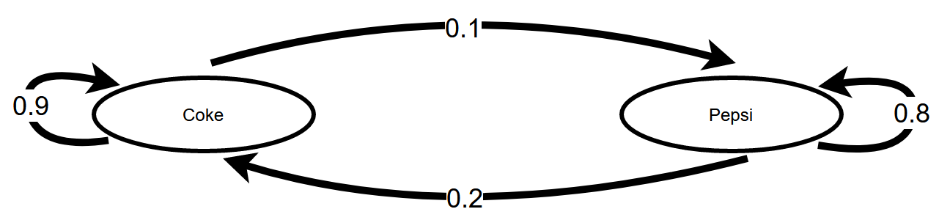

Examples 2
Given a person is currently a Pepsi purchaser. What is the probability of purchase of coke after two purchases from now?
Coke => 90% Coke
Pepsi => 20% Coke
P = $\left(\begin{matrix}0.9 & 0.1 \\ 0.2 & 0.8\end{matrix}\right)$;
Xo =??
X2 = ??

Slide 18
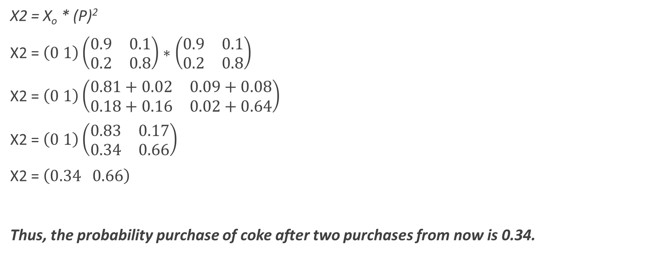
Examples 2
X2 = X_{o} * (P)²
X2 = $\left(0 1\right)\left(\begin{matrix}0.9 & 0.1 \\ 0.2 & 0.8\end{matrix}\right)∗\left(\begin{matrix}0.9 & 0.1 \\ 0.2 & 0.8\end{matrix}\right)$
X2 = $\left(0 1\right)\left(\begin{matrix}0.81+0.02 & 0.09+0.08 \\ 0.18+0.16 & 0.02+0.64\end{matrix}\right)$
X2 = $\left(0 1\right)\left(\begin{matrix}0.83 & 0.17 \\ 0.34 & 0.66\end{matrix}\right)$
X2 = $\left(0.34 0.66\right)$
Thus, the probability purchase of coke after two purchases from now is 0.34.

Slide 19
Exercise
What will be probability if todays is raining then not rain after three days?(Example 1 data)
X0 = ???; X3 = ???
Given a person is currently a Coke purchaser. What is the probability of purchase of Pepsi after 3 purchase? (Example 2 data)
X0= ??; X3 = ??

Slide 20
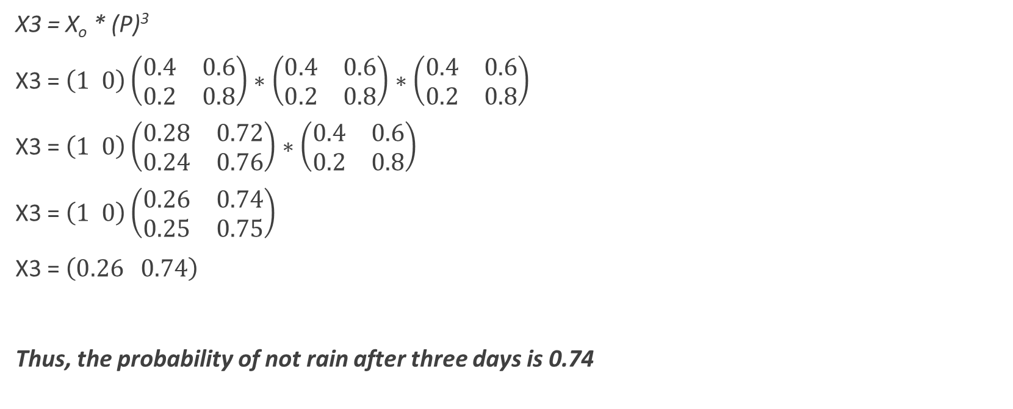
Exercise 1 answer
X3 = X_{o} * (P)³
X3 = $\left(1 0\right)\left(\begin{matrix}0.4 & 0.6 \\ 0.2 & 0.8\end{matrix}\right)∗\left(\begin{matrix}0.4 & 0.6 \\ 0.2 & 0.8\end{matrix}\right)∗\left(\begin{matrix}0.4 & 0.6 \\ 0.2 & 0.8\end{matrix}\right)$
X3 = $\left(1 0\right)\left(\begin{matrix}0.28 & 0.72 \\ 0.24 & 0.76\end{matrix}\right)∗\left(\begin{matrix}0.4 & 0.6 \\ 0.2 & 0.8\end{matrix}\right)$
X3 = $\left(1 0\right)\left(\begin{matrix}0.26 & 0.74 \\ 0.25 & 0.75\end{matrix}\right)$
X3 = $\left(0.26 0.74\right)$
Thus, the probability of not rain after three days is 0.74

Slide 21
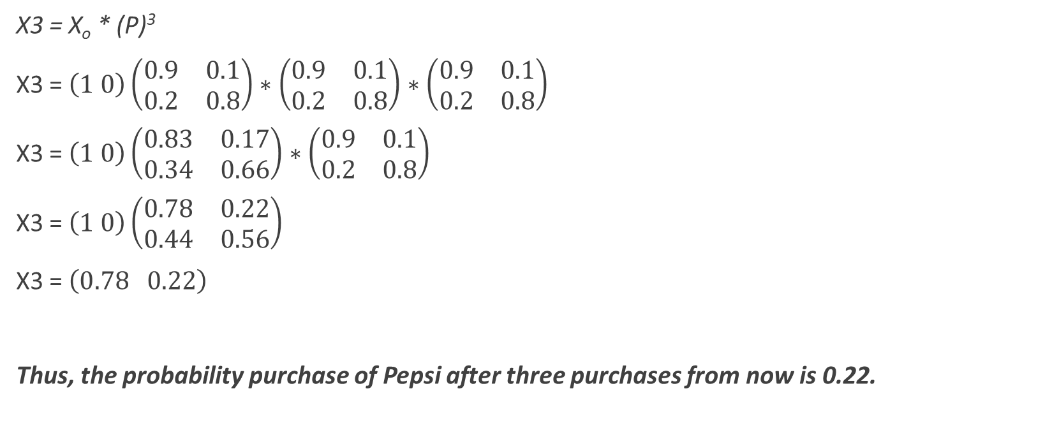
Exercise 2 answer
X3 = X_{o} * (P)³
X3 = $\left(1 0\right)\left(\begin{matrix}0.9 & 0.1 \\ 0.2 & 0.8\end{matrix}\right)∗\left(\begin{matrix}0.9 & 0.1 \\ 0.2 & 0.8\end{matrix}\right)∗\left(\begin{matrix}0.9 & 0.1 \\ 0.2 & 0.8\end{matrix}\right)$
X3 = $\left(1 0\right)\left(\begin{matrix}0.83 & 0.17 \\ 0.34 & 0.66\end{matrix}\right)∗\left(\begin{matrix}0.9 & 0.1 \\ 0.2 & 0.8\end{matrix}\right)$
X3 = $\left(1 0\right)\left(\begin{matrix}0.78 & 0.22 \\ 0.44 & 0.56\end{matrix}\right)$
X3 = $\left(0.78 0.22\right)$
Thus, the probability purchase of Pepsi after three purchases from now is 0.22.

Slide 22
Application
Since Markov chains can be designed to model many real-world processes, they are used in a wide variety of situations.
These fields range from the mapping of animal life populations to search engine algorithms, music composition and speech recognition.
In economics and finance, they are often used to predict macroeconomic situations like market crashes and cycles between recession and expansion. Other areas of application include predicting asset and option prices and calculating credit risks.
Notes:
Modeling random processes: Markov chains can be used to model random processes that have a finite number of possible states. For example, a Markov chain could be used to model the weather, where the possible states might be "sunny", "cloudy", and "rainy".

Slide 23
Application
In biology, Markov chains are often used to model the evolution of populations over time, the spread of diseases through a population, and other processes that involve transitions between different states.
In economics, Markov chains are often used to model the behavior of financial markets, the movement of goods and people between different regions, and other processes that involve transitions between different states.
In physics, Markov chains are often used to model the behavior of complex systems that can be in multiple states and undergo transitions between those states
Modeling communication channels: Markov chains can be used to model the behavior of communication channels, such as those used in computer networks or telecommunications.
Modeling queues: Markov chains can be used to model queues, such as those found in hospitals or call centers.
Modeling population dynamics: Markov chains can be used to model the dynamics of a population, such as the spread of a disease through a population or the evolution of a species.

Slide 24
Application
Google’s PageRank algorithm treats the web like a Markov model.
The PageRank algorithm uses a variant of a Markov chain, a mathematical model that involves transitions between different states. In this case, the states are websites, and the transitions between states are links from one website to another. By iteratively applying the transition probabilities, the PageRank algorithm can calculate the importance of each website and rank them accordingly.
If you use Gmail, you must’ve noticed their Auto-fill feature. This feature automatically predicts your sentences to help you write emails quickly. Markov chains help in this sector considerably as they can provide predictions of this sort effectively.
Gmail's autocomplete feature uses machine learning algorithms to analyze the words and phrases that you have typed in the past, and it uses this information to predict and suggest words or phrases as you type. It is possible that the feature uses a variant of a Markov model, or a similar approach, to analyze the patterns of word usage and predict future word choices.

Slide 25
Exercise
Explain the Markov chains with examples and its applications.
What are the key features of Markov chains

Slide 26
Lab 2
Question 1 : Suppose you are designing a new web browser and you want to optimize the way it handles requests for new web pages. You decide to use a Markov chain to model the process of requesting and loading web pages.
The possible states of the Markov chain are "idle", "requesting", and "loading". At any given time, the browser is either idle (not requesting any new pages), requesting a new page, or loading a page that has already been requested. The transitions between these states are governed by the following rules:
If the browser is idle, it has a 50% chance of transitioning to the "requesting" state and a 50% chance of staying idle.
If the browser is requesting a page, it has a 75% chance of transitioning to the "loading" state and a 25% chance of returning to the "idle" state.
If the browser is loading a page, it has a 100% chance of transitioning back to the "idle" state once the page has finished loading.
Given this information, if the browser is currently idle, use the Markov chain to calculate the probability that it will remain idle, request a new page, or begin loading a page on the next time step.

Slide 27
Lab 2
Question 2 : Suppose you are designing a new ride-sharing app and you want to optimize the way it matches drivers with riders. You decide to use a Markov chain to model the process of matching drivers and riders.
The possible states of the Markov chain are "idle", "waiting", and "matched". At any given time, a driver is either idle (not currently carrying a rider), waiting for a rider to request a ride, or matched with a rider (driving to the rider's destination). The transitions between these states are governed by the following rules:
If the driver is idle, it has a 20% chance of transitioning to the "waiting" state and a 80% chance of staying idle.
If the driver is waiting for a ride request, it has a 60% chance of transitioning to the "matched" state (if a rider requests a ride) and a 40% chance of returning to the "idle" state.
If the driver is matched with a rider, it has a 100% chance of transitioning back to the "idle" state once the ride is completed.
Given this information, if a driver is currently idle, use the Markov chain to calculate the probability that the driver will remain idle, begin waiting for a ride request, or become matched with a rider on the next time step.

Slide 28
Lab 2
Question 3 : Suppose you are designing a new delivery robot for a warehouse and you want to optimize its route through the warehouse. You decide to use a Markov chain to model the robot's movements.
The possible states of the Markov chain are the locations in the warehouse, and the transitions between states represent the robot moving from one location to another. The transitions between states are governed by the following rules:
If the robot is currently at location A, it has a 30% chance of staying at location A, a 40% chance of moving to location B, and a 30% chance of moving to location C.
If the robot is currently at location B, it has a 50% chance of staying at location B and a 50% chance of moving to location C.
If the robot is currently at location C, it has a 20% chance of staying at location C, a 30% chance of moving to location A, and a 50% chance of moving to location B.
Given this information, if the robot is currently at location A, use the Markov chain to calculate the probability that it will remain at location A, move to location B, or move to location C on the next time step.

